Slide 1

Object Oriented Programming with Java (Subject Code: BCS-403)
Unit 3
Lecture 21

Slide 2
Lecture 21
Functional Interfaces
Lambda Expression

Slide 3
Functional Interfaces
A functional interface is an interface that contains only one abstract method.
They can have only one functionality to exhibit.
From Java 8 onwards, lambda expressions can be used to represent the instance of a functional interface.
A functional interface can have any number of default methods.
Runnable, ActionListener, and Comparable are some of the examples of functional interfaces.

Slide 4
Functional Interface is additionally recognized as Single Abstract Method Interfaces.
In short, they are also known as SAM interfaces.
Functional interfaces in Java are the new feature that provides users with the approach of fundamental programming.
Functional interfaces are included in Java SE 8 with Lambda expressions and Method references in order to make code more readable, clean, and straightforward.

Slide 5
Functional interfaces are interfaces that ensure that they include precisely only one abstract method.
Functional interfaces are used and executed by representing the interface with an annotation called @FunctionalInterface.

Slide 6
In Functional interfaces, there is no need to use the abstract keyword as it is optional to use the abstract keyword because, by default, the method defined inside the interface is abstract only.
We can also call Lambda expressions as the instance of functional interface.

Slide 7
class Test {
public static void main(String args[])
{
// create anonymous inner class object
new Thread(new Runnable() {
@Override public void run()
{
System.out.println("New thread created");
}
}).start();
}
}

Slide 8
// functional interface using lambda expressions
class Test {
public static void main(String args[])
{
// lambda expression to create the object
new Thread(() -> {
System.out.println("New thread created");
}).start();
}
}

Slide 9
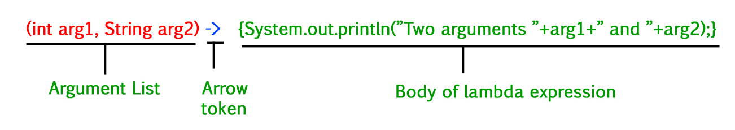
Lambda Expression in Java
Lambda Expressions in Java are the same as lambda functions which are the short block of code that accepts input as parameters and returns a resultant value.
Lambda Expression Syntax
lambda operator -> body

Slide 10
There are three Lambda Expression Parameters are mentioned below:
Zero Parameter
Single Parameter
Multiple Parameters

Slide 11
1. Lambda Expression with Zero parameter
() -> System.out.println("Zero parameter lambda");
2. Lambda Expression with Single parameter
(p) -> System.out.println("One parameter: " + p);
3. Lambda Expression with Multiple parameters
(p1, p2) -> System.out.println("Multiple parameters: " + p1 + ", " + p2);

Slide 12

Example of Lambda Expression with one parameter
//functional interface
interface NumericTest{
boolean test(int n);
}
public class LambdaDemo1 {
public static void main(String args[]) {
NumericTest isEven= (n) -> (n%2)==0;
if(isEven.test(10)) System.out.println("10 is even");
if(!isEven.test(9)) System.out.println("9 is not even");
}
}

Slide 13
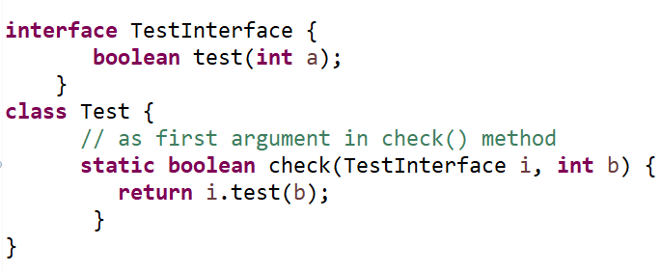
Passing Lambda Expression as arguments
To pass a lambda expression as a method parameter in java, the type of method parameter that receives must be of functional interface type.

Slide 14
@FunctionalInterface Annotation
@FunctionalInterface annotation is used to ensure that the functional interface can’t have more than one abstract method.
In case more than one abstract methods are present, the compiler flags an ‘Unexpected @FunctionalInterface annotation’ message. However, it is not mandatory to use this annotation.

Slide 15
@FunctionalInterface
interface Square {
int calculate(int x);
}
class Test1 {
public static void main(String args[])
{
int a = 5;
// lambda expression to define the calculate method
Square s = (int x) -> x * x;
// parameter passed and return type must be
// same as defined in the prototype
int ans = s.calculate(a);
System.out.println(ans);
}}

Slide 16
Some Built-in Java Functional Interfaces
Since Java SE 1.8 onwards, there are many interfaces that are converted into functional interfaces. All these interfaces are annotated with @FunctionalInterface.
These interfaces are as follows
Runnable –> This interface only contains the run() method.
Comparable –> This interface only contains the compareTo() method.
ActionListener –> This interface only contains the actionPerformed() method.
Callable –> This interface only contains the call() method.

Slide 17
Java SE 8 included four main kinds of functional interfaces which can be applied in multiple situations as mentioned below:
Consumer
Predicate
Function
Supplier

Slide 18
1. Consumer
The consumer interface of the functional interface is the one that accepts only one argument or a gentrified argument.
The consumer interface has no return value. It returns nothing.
There are also functional variants of the Consumer — DoubleConsumer, IntConsumer, and LongConsumer.
These variants accept primitive values as arguments.
.

Slide 19
Bi-Consumer
Other than these variants, there is also one more variant of the Consumer interface known as Bi-Consumer
Bi-Consumer is the most exciting variant of the Consumer interface.
Bi-Consumer interface takes two arguments.
Both, Consumer and Bi-Consumer have no return value.
It also returns nothing just like the Consumer interface.
It is used in iterating through the entries of the map.

Slide 20
Syntax / Prototype of Consumer Functional Interface –
Consumer<Integer> consumer = (value) -> System.out.println(value);

Slide 21
2. Predicate
In scientific logic, a function that accepts an argument and, in return, generates a boolean value as an answer is known as a predicate.
Syntax of Predicate Functional Interface –
public interface Predicate<T>
{
boolean test(T t);
}

Slide 22
Bi-Predicate
Bi-Predicate is also an extension of the Predicate functional interface, which, instead of one, takes two arguments, does some processing, and returns the boolean value.

Slide 23
Example of the implementation of the Predicate functional interface is
Predicate predicate = (value) -> value != null;

Slide 24
3. Function
A function is a type of functional interface in Java that receives only a single argument and returns a value after the required processing.
There are many versions of Function interfaces because a primitive type can’t imply a general type argument, so we need these versions of function interfaces.

Slide 25
Bi-Function
The Bi-Function is substantially related to a Function. Besides, it takes two arguments, whereas Function accepts one argument.
syntax of Bi-Function
@FunctionalInterface
public interface BiFunction<T, U, R>
{
R apply(T t, U u);
}
T and U are the inputs, and there is only one output which is R.

Slide 26
Unary Operator and Binary Operator
There are also two other functional interfaces which are named Unary Operator and Binary Operator.
They both extend the Function and Bi-Function, respectively.
In simple words, Unary Operator extends Function, and Binary Operator extends Bi-Function.

Slide 27
The prototype of the Unary Operator and Binary Operator is mentioned below
@FunctionalInterface
public interface UnaryOperator<T> extends Function<T, U>
{
……...
}
@FunctionalInterface
public interface BinaryOperator<T> extends BiFunction<T, U, R>
{
……...
}

Slide 28
4. Supplier
The Supplier functional interface is also a type of functional interface that does not take any input or argument and yet returns a single output.
This type of functional interface is generally used in the lazy generation of values.
Supplier functional interfaces are also used for defining the logic for the generation of any sequence.

Slide 29
For example –
The logic behind the Fibonacci Series can be generated with the help of the Stream. generate method, which is implemented by the Supplier functional Interface.
// lambda expression to create object
Predicate<String> p = (s) -> s.startsWith("G");

